Slide 1
Aligning Assessments With Your Instructional Strategy
• Understand the relationship between learning objectives and exam questions
• Define discrimination, validity, and reliability for exams
• Know how discrimination, validity, and reliability support long-term data integrity
• Be able to communicate exam strategy to a client
• Demonstrate the ability to assess the strength of exam questions
• Write a brief test on a training case study
Notes:
Audience expectations:
I am going to need some participation – I will be asking polling questions
Feel free to raise your hand to ask questions or make a remark
What we are not going to cover – Detailed strategy, statistical theory or modeling (it’s too early in the morning for that), gamifying tests – those are topics for another day, this is the basics.

Slide 2

What is the purpose of an assessment?
Data
Evaluation of Materials
Compliance (Internal/External)
Because “they” want one
Notes:
Ask the audience the title question – If I don’t get an immediate response, ask how have you used assessments in your workplace?
Show the list: Ask which one of these is not like the other?
What do I mean by data? Learning programs need, and deserve, a good data strategy. Test implementation is the best, and simplest, way to build a foundational data strategy.
Along with aligning to specific business metrics, using strong tests will provide a foundation for analytics in your learning.
Evaluation of materials: The data really yields a level 2 evaluation – how are students learning – What can you do with this info? What changes can you make?
Important for instructor evaluation (for ILT), development practices (eLearning), and client alignment. You will make your curriculum changes based on the data platform you establish.
Compliance: Self explanatory – sometimes you HAVE to test, why not make it good? Additionally, compliance with legal standards for defending tests that will lead to HR action.

Slide 3
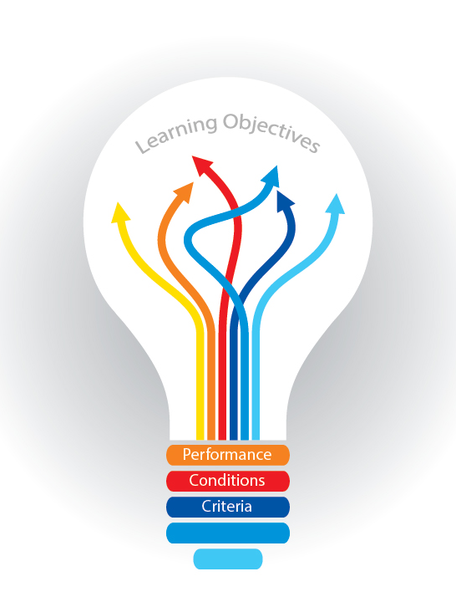
Aligning Your Tests
Use Design Documents
Use a test item matrix
Develop concrete instructional objectives
Gain stakeholder buy in
Notes:
How do you make sure you are developing well-aligned (with business needs and instructional needs) tests?
Discuss each example a bit – don’t dive too deep outside of the instructional objectives
Design Documents – Include your testing strategy and data management in your design document to share with stakeholders
Test Item Matrix – A lot of people are familiar with test banks, but how many are matrixed to instructional objectives and business metrics (this can be a slippery slope)? Doing this will make exam tracking and data management easier
Stakeholder Buy-In – Your testing strategy should be well socialized with stakeholders – does your audience believe in what you are doing?
Instructional Objectives: You NEED instructional objectives if you are writing tests – these two MUST be linked to one another in order to use that data from the tests. Otherwise, what are you testing?
Mention test item matrix.

Slide 4

Constructing a Titanium Exam
Validity
Reliability
Discrimination
If a test is unreliable, it cannot be valid.
For a test to be valid, it must reliable.
However, just because a test is reliable does not mean it will be valid.
Reliability is a necessary but not sufficient condition for validity!
Notes:
Validity: What is validity as it relates to an assessment?
Content Validity - A test has content validity if it measures knowledge of the content domain of which it was designed to measure knowledge. Another way of saying this is that content validity concerns, primarily, the adequacy with which the test items adequately and representatively sample the content area to be measured.
Criterion Validity: Criterion-related validity is a concern for tests that are designed to predict someone’s status on an external criterion measure.
Construct Validity: Accurately measuring a theoretical trait
Reliability: a test is reliable a) to the degree that it is free from error and provides information about examinees’ "true" test scores and b) to the degree that it provides repeatable, consistent results. Test item analysis will yield greater than 90% reliability if the test is best in class – 70-80% means your test is sufficiently reliable.
Discrimination: refers to the degree to which items differentiate among examinees in terms of the characteristic being measured (e.g., between high and low scorers). This can be measured in many ways. One method is to correlate item responses with the total test score; items with the highest test correlation with the total score are retained for the final version of the test.
Think of this as creating a sufficiently difficult test.

Slide 5

Communicating Your Strategy
I believe in using three primary channels:
  Client Meetings
  Leadership Meetings
  Email Socialization
Notes:
Ask the audience: What are some ways you communicate strategic decisions with your stakeholders?
Follow up with people giving answers: Has one way been more successful than others?
Client Meetings: Communicate the importance of detail orientation with regard to testing theory – really get in the weeds here. This is where you gain long term buy in with the client for future engagement. They won’t question you in the future
Leadership Meetings: High level overview of data integrity. Leadership loves data – and learning/training don’t typically have strong data strategies. Wow your leaders with the concept and proof of your test data program.
Email Socialization: People hate taking tests (unless you make them fun, but that’s a different topic). This is where you give the WIFFM to your audience. “Hey everyone – we want to make sure we are giving you training that is a good use of your time. Our tests are designed to ensure we keep our curriculum relevant and stable.”

Slide 6
Some Test Writing Tips
True/False isn’t the devil – but keep them sparse. These are tough on reliability
Fill in the blank makes your job difficult
Keep answers of similar length
Ensure answers meet discrimination standards (there is a right one)
Never have one obvious wrong answer or two overly similar answers – give reasonable distractors
Don’t be vague
Make your SMEs take the tests – if they can’t pass them, something is wrong
More Tips
Notes:
Some test tips – talk about each one briefly –
focus on risks of not meeting these standards (DATA DATA DATA) – Ask questions throughout – what do you think are the risks of not following these tips?

Slide 7
Examples of Questions
California:
a. Contains the tallest mountain in the United States.
b. Has an eagle on its state flag.
c. Is the second largest state in terms of area.
d. Was the location of the Gold Rush of 1849.
Why is adequate lighting necessary in a balanced aquarium?
Fish need light to see their food.
Fish take in oxygen in the dark.
Plants expel carbon dioxide in the dark.
Plants grow too rapidly in the dark.
Which one of the following best illustrates the law of diminishing returns?
The demand for a farm product increased faster than the supply of the product.
The population of a country increased faster than the means of subsistence.
A machine decreased in utility as its parts became worn.
A factory doubled its labor force and increased production by 50 percent.
What is the average effective radiation dose from chest CT?
a. 1-8 mSv
b. 8-16 mSv
c. 16-24 mSv
d. 24-32 mSv
Notes:
This will be an exercise in participation:
Why are each of these questions good?
What about them could be improved

Slide 8
Your client has approached you to develop training that must have an exam. You’ve completed
a detailed needs analysis and created a great learning solution.
Given the information in your hand out, write a 3-5 question quiz that meets test development
standards. The learning objectives of the training are below. Use your imagination on the details.
These are your learning objectives:
Know the steps to enter an address into your car’s GPS
Given a picture of your car’s GPS, identify the make and model
Be able to adjust the settings of your car’s GPS to remove highway driving
Notes:
Pass out the hand out during the talk.

Slide 9
Implement
Socialize you strategy
Write some tests, build your tools, and watch your data bank grow!
Develop a strategy
Evaluate your strategy
Set meetings with clients and leadership – get them excited about DATA
Decide what is important to you. Do you need 90% reliability? How long will your evaluation period be?
Do you use tests? Are they good tests? Can they meet professional standards?

